Slide 1
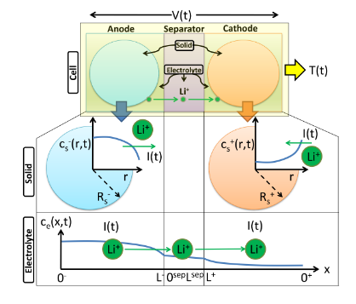
电化学参数辨识背景
需求背景
工业需求驱动
电动汽车产业快速发展，要求更精确的电池管理系统
储能系统规模扩大，需要准确的电池状态估计
电池制造质量控制需要可靠的参数表征方法
技术发展基础
计算能力的提升使得复杂算法可实现
传感器技术进步提供更丰富的测量数据
高精度仿真为参数辨识提供新方法
电池P2D模型
研究现状
当前不足
传统方法
电化学阻抗谱(EIS)测量
循环伏安法(CV)表征
恒流充放电测试(GITT/HPPC)
新兴方法
机器学习辅助参数辨识
在线自适应参数估计
多尺度混合辨识方法
方法局限性
大多数方法仅适用于特定工况
缺乏统一的评价标准
可解释性不足
2.实用性问题
计算复杂度过高
需要专业设备
支持应用场景受限
Notes:
Theoretical advantages:
High computational efficiency
The algorithm complexity is O (n), requiring only one traversal and simple numerical operations
No need to retrain the model, it can be directly applied to the prediction stage
Compared to sampling methods such as SMOTE, it does not increase training overhead
Good mathematical properties
Maintaining the basic constraint of probability sum of 1
Adaptive adjustment of probability distribution is achieved through threshold mechanism
The design of the amplification factor ensures the rationality of the proportion of probability redistribution

Slide 2
基于全局敏感性分析的参数选择
参数准备
定义问题字典（参数名称、范围）
Saltelli采样
生成结构化采样矩阵
模型评估
对每个采样点进行模型计算
Sobol全局敏感性分析
设定采样数量
确保采样覆盖性和效率
收集输出结果
使用特定结构的输出结果
计算各类敏感性指标
针对电化学模型适用性强
电化学参数 | 一阶指数 (S1) | 总指数 (ST) | 交互效应 (ST-S1)
负极锂离子初始浓度 | 0.5024 | 0.9087 | 0.4063
负极厚度 | 0.2285 | 0.5904 | 0.3619
正极厚度 | 0.1604 | 0.3112 | 0.1508
正极活性材料比例 | 0.1571 | 0.2676 | 0.1105
正极锂离子最大浓度 | 0.0545 | 0.4990 | 0.4445
非线性特性处理：
电化学模型具有强非线性特性
参数间存在复杂的耦合关系
Sobol方法不受模型线性假设限制
2. 定量评估能力：
一阶敏感性指数(S1)：反映单个参数的直接影响
总敏感性指数(ST)：包含参数的所有交互效应
交互效应(ST-S1)：揭示参数间的耦合强度
3. 结果可靠性：
提供敏感性指标的置信区间
支持不同参数重要性的统计检验
参数筛选：
ST < 0.01可考虑忽略
S1接近ST表示主要为直接效应
ST >> S1表示强交互作用
Notes:
Theoretical advantages:
High computational efficiency
The algorithm complexity is O (n), requiring only one traversal and simple numerical operations
No need to retrain the model, it can be directly applied to the prediction stage
Compared to sampling methods such as SMOTE, it does not increase training overhead
Good mathematical properties
Maintaining the basic constraint of probability sum of 1
Adaptive adjustment of probability distribution is achieved through threshold mechanism
The design of the amplification factor ensures the rationality of the proportion of probability redistribution

Slide 3
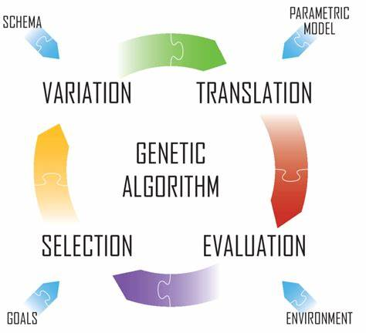
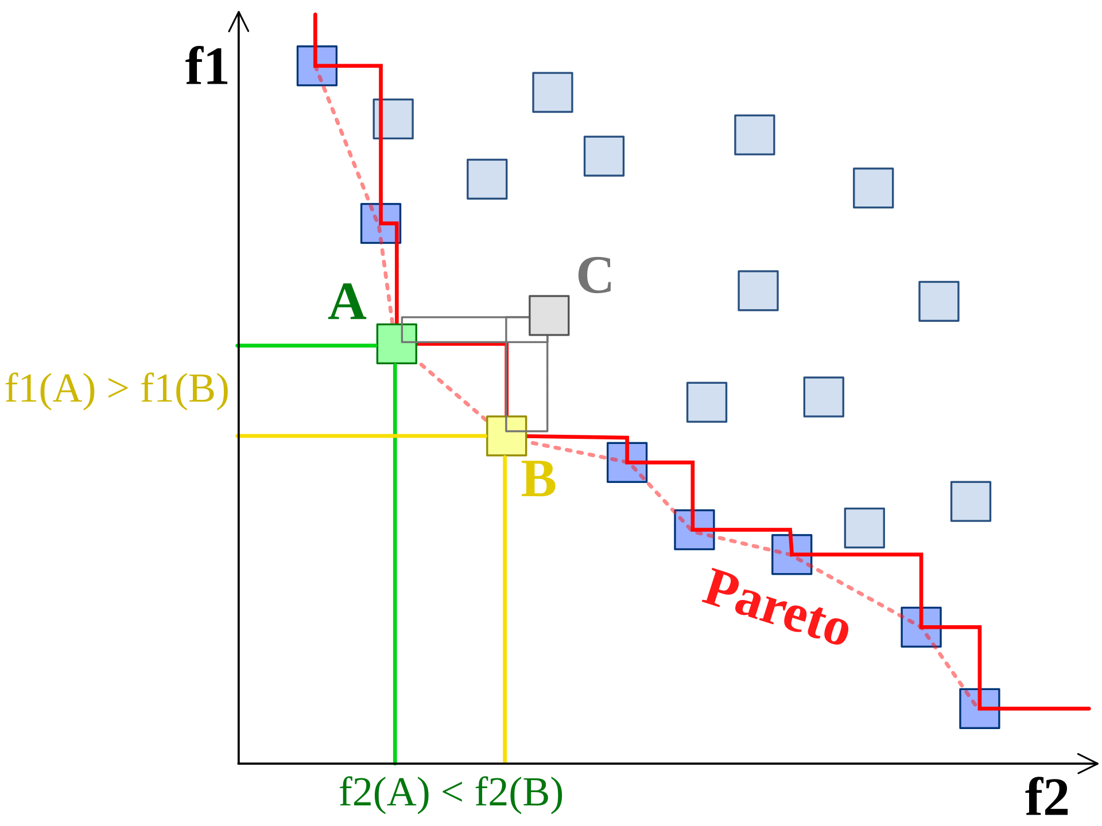
非支配排序基因算法（NSGA）
敏感性分析筛选关键参数
参数编码与种群初始化
非支配排序分层
拥挤度计算与选择
NSGA算法的显著优势
Pareto优化： NSGA基于Pareto支配的概念，通过将解空间划分为不同的非支配前沿，并保持解的多样性，能够找到较好的Pareto前沿解集。
高收敛性： NSGA采用了快速非支配排序和拥挤度距离的策略，能够在多目标优化问题中具有较好的收敛性。它可以快速收敛到Pareto前沿，并提供多样性和均匀分布的解。
适应于多目标问题： NSGA适用于多目标优化问题，能够同时优化多个冲突的目标。它可以处理带约束和非约束的多目标优化问题，适应范围广。
参数较少： NSGA相对简单，参数较少，易于实现和应用。一般只需要设置种群大小、交叉概率和变异概率等少数几个参数。
高效的非支配排序和拥挤距离计算： NSGA-II算法采用快速非支配排序算法对种群中的个体进行排序。
基因算法
帕累托最优
Notes:
Theoretical advantages:
High computational efficiency
The algorithm complexity is O (n), requiring only one traversal and simple numerical operations
No need to retrain the model, it can be directly applied to the prediction stage
Compared to sampling methods such as SMOTE, it does not increase training overhead
Good mathematical properties
Maintaining the basic constraint of probability sum of 1
Adaptive adjustment of probability distribution is achieved through threshold mechanism
The design of the amplification factor ensures the rationality of the proportion of probability redistribution

Slide 4
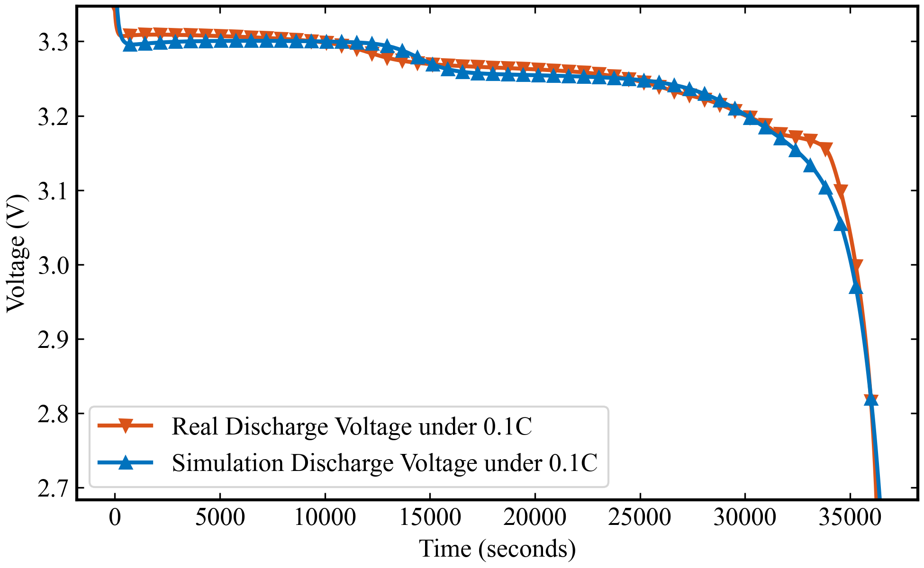
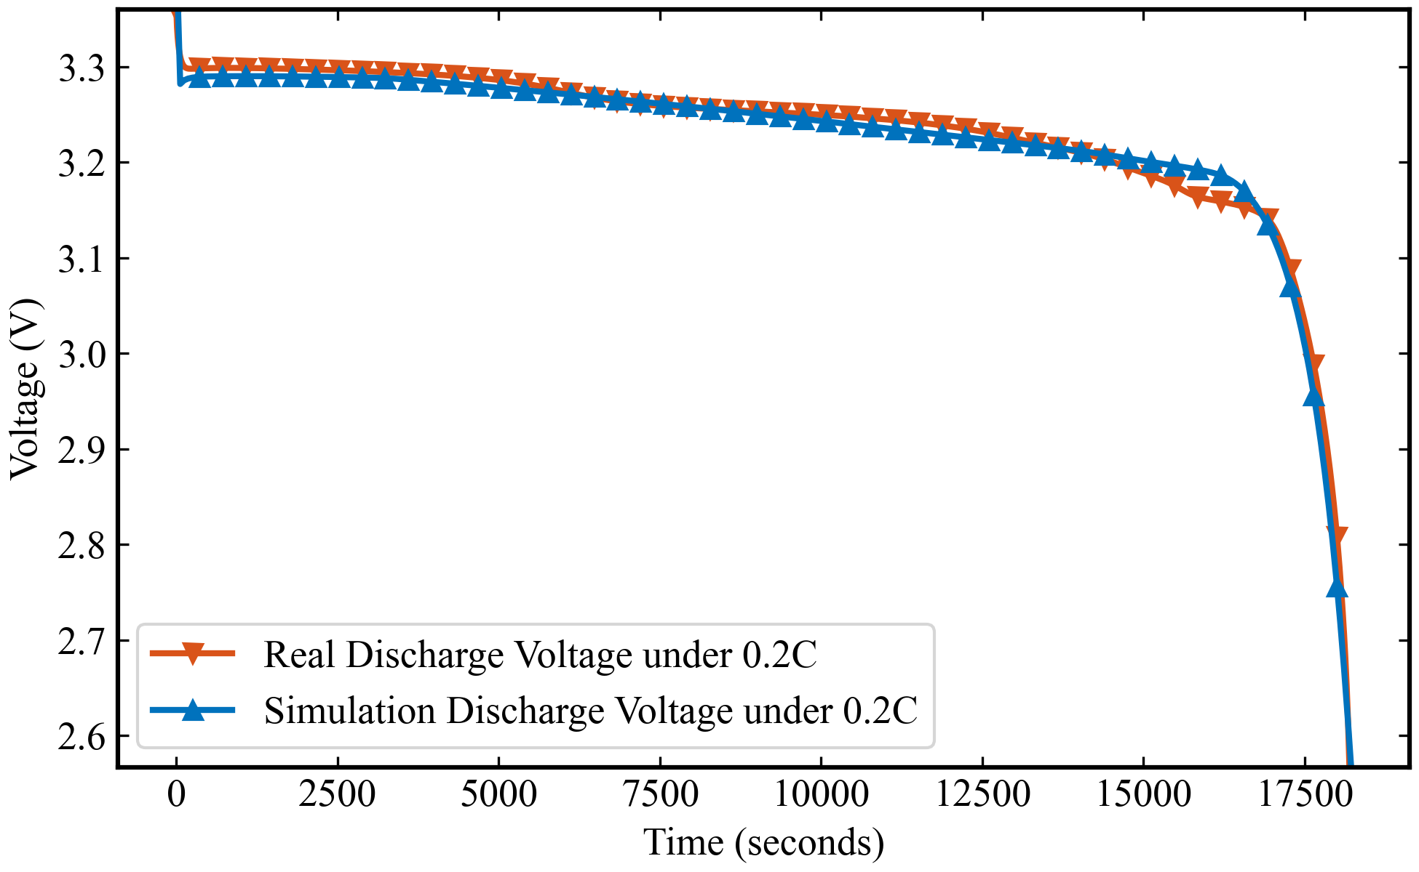
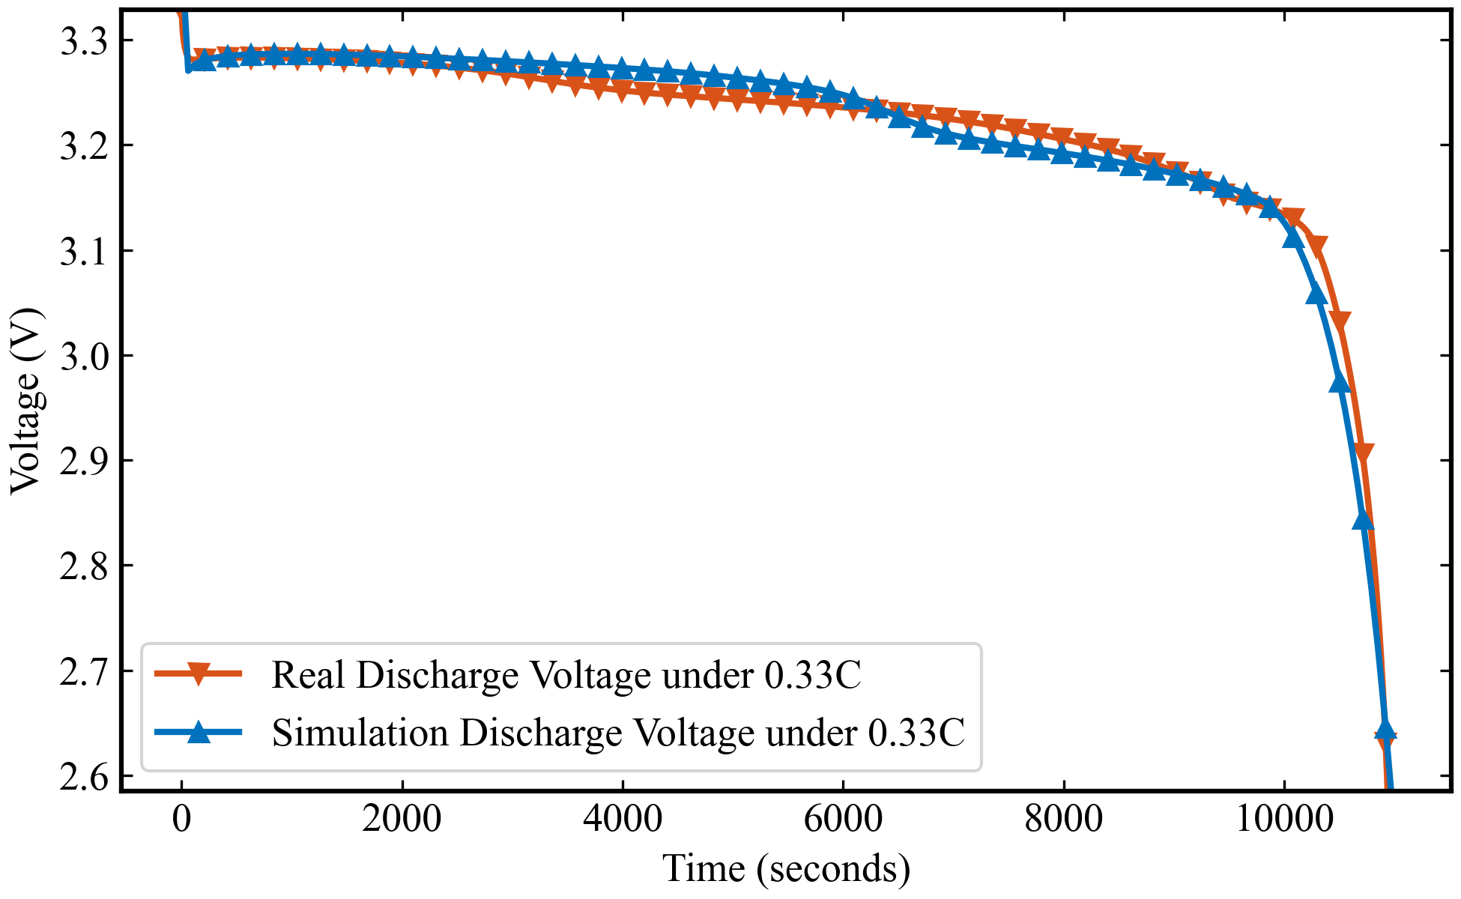
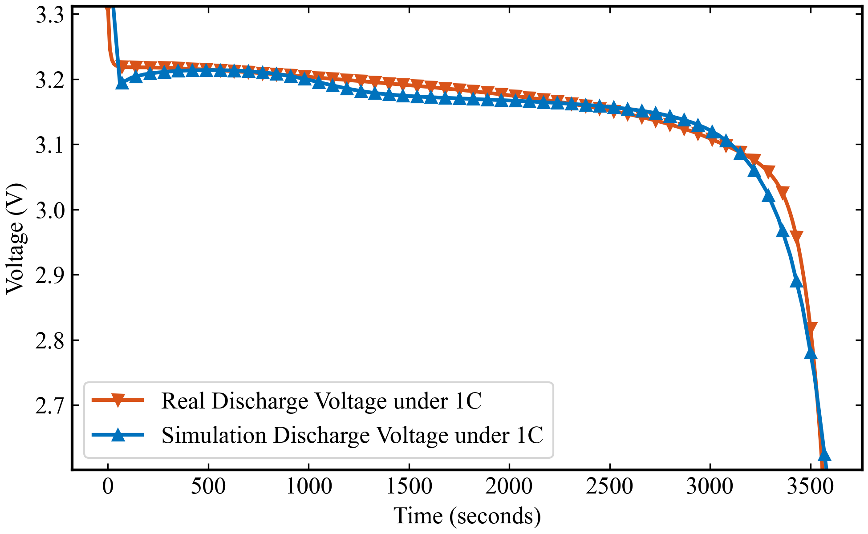
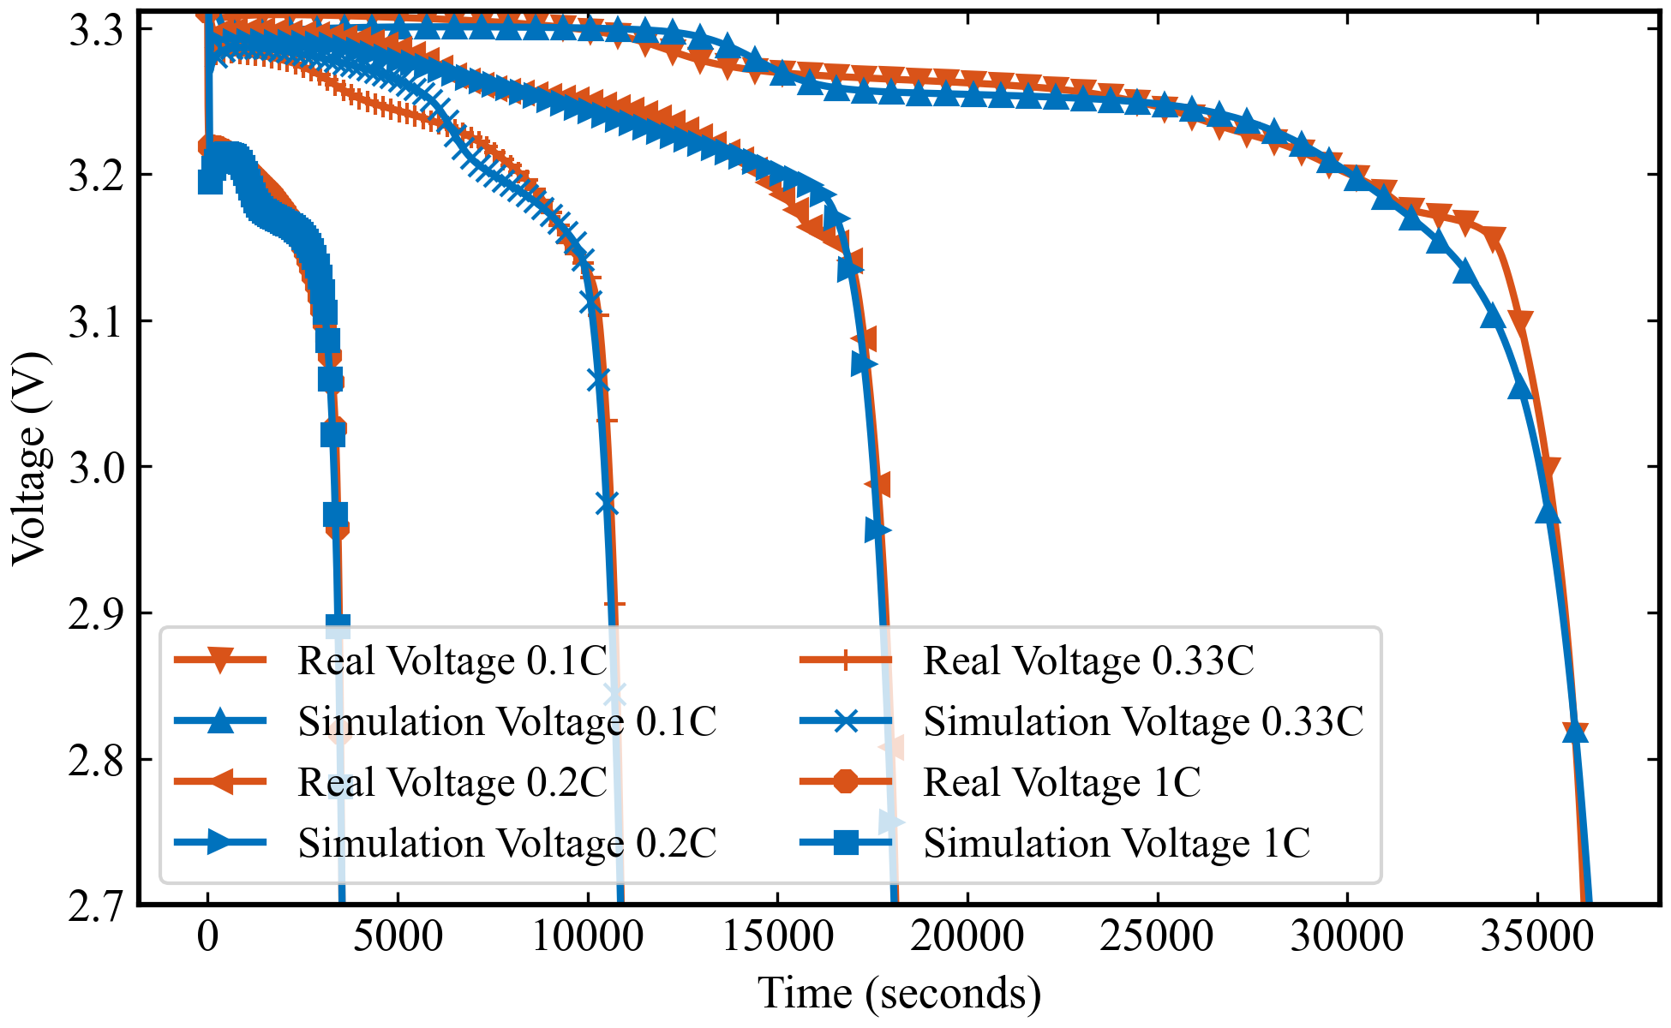
单工况参数辨识实验结果
RMSE for 0.1C: 7.4 mV
RMSE for 0.2C: 6.0 mV
RMSE for 0.33C: 12.5 mV
RMSE for 1C: 10.3 mV
算法：NSGA 电池模型：DFN
参数量：42 不同工况独立训练，得出的参数不同
DFN模型是一个基于物理的电池模型，它源自于Doyle等人的工作，并由Fuller和Newman进一步发展。这个模型详细描述了锂离子电池的电化学行为，包括锂离子在电极中的扩散、电解液中锂离子的迁移和电池的电荷平衡。
DFN模型能够模拟电池的电压响应，预测电池性能，并且是理解和预测电池退化现象的重要工具。
Notes:
Theoretical advantages:
High computational efficiency
The algorithm complexity is O (n), requiring only one traversal and simple numerical operations
No need to retrain the model, it can be directly applied to the prediction stage
Compared to sampling methods such as SMOTE, it does not increase training overhead
Good mathematical properties
Maintaining the basic constraint of probability sum of 1
Adaptive adjustment of probability distribution is achieved through threshold mechanism
The design of the amplification factor ensures the rationality of the proportion of probability redistribution

Slide 5
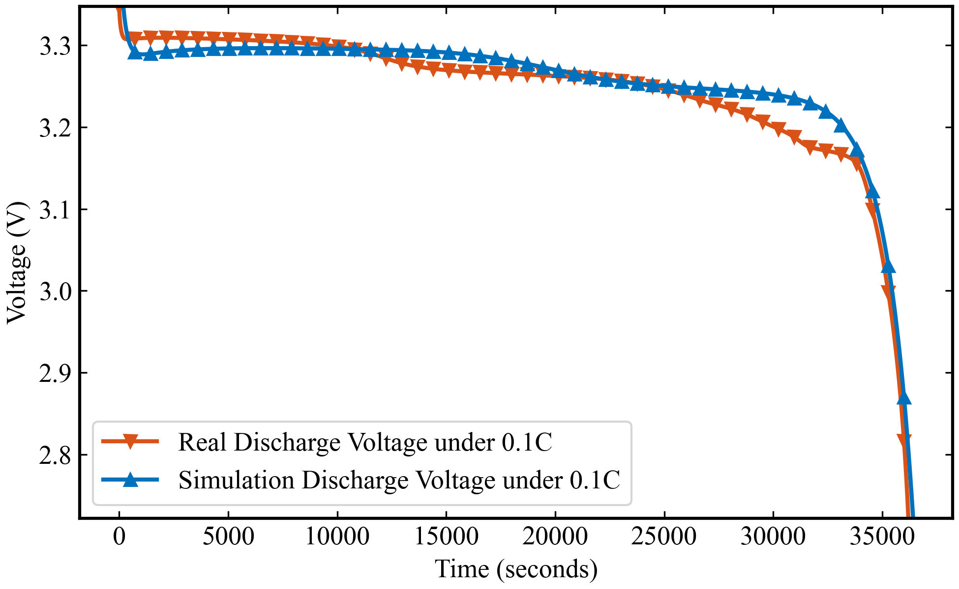
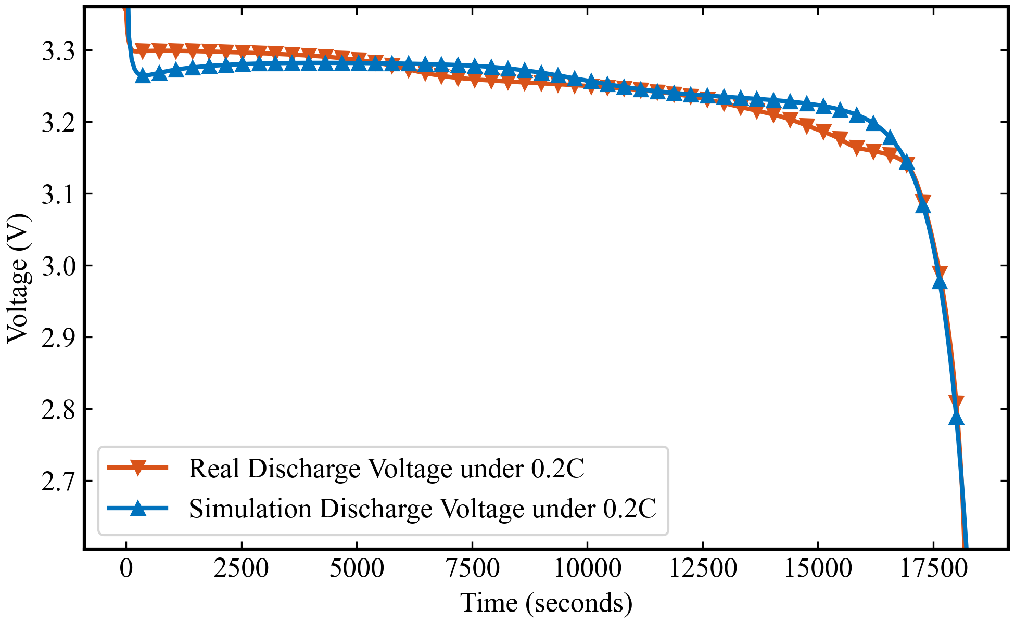
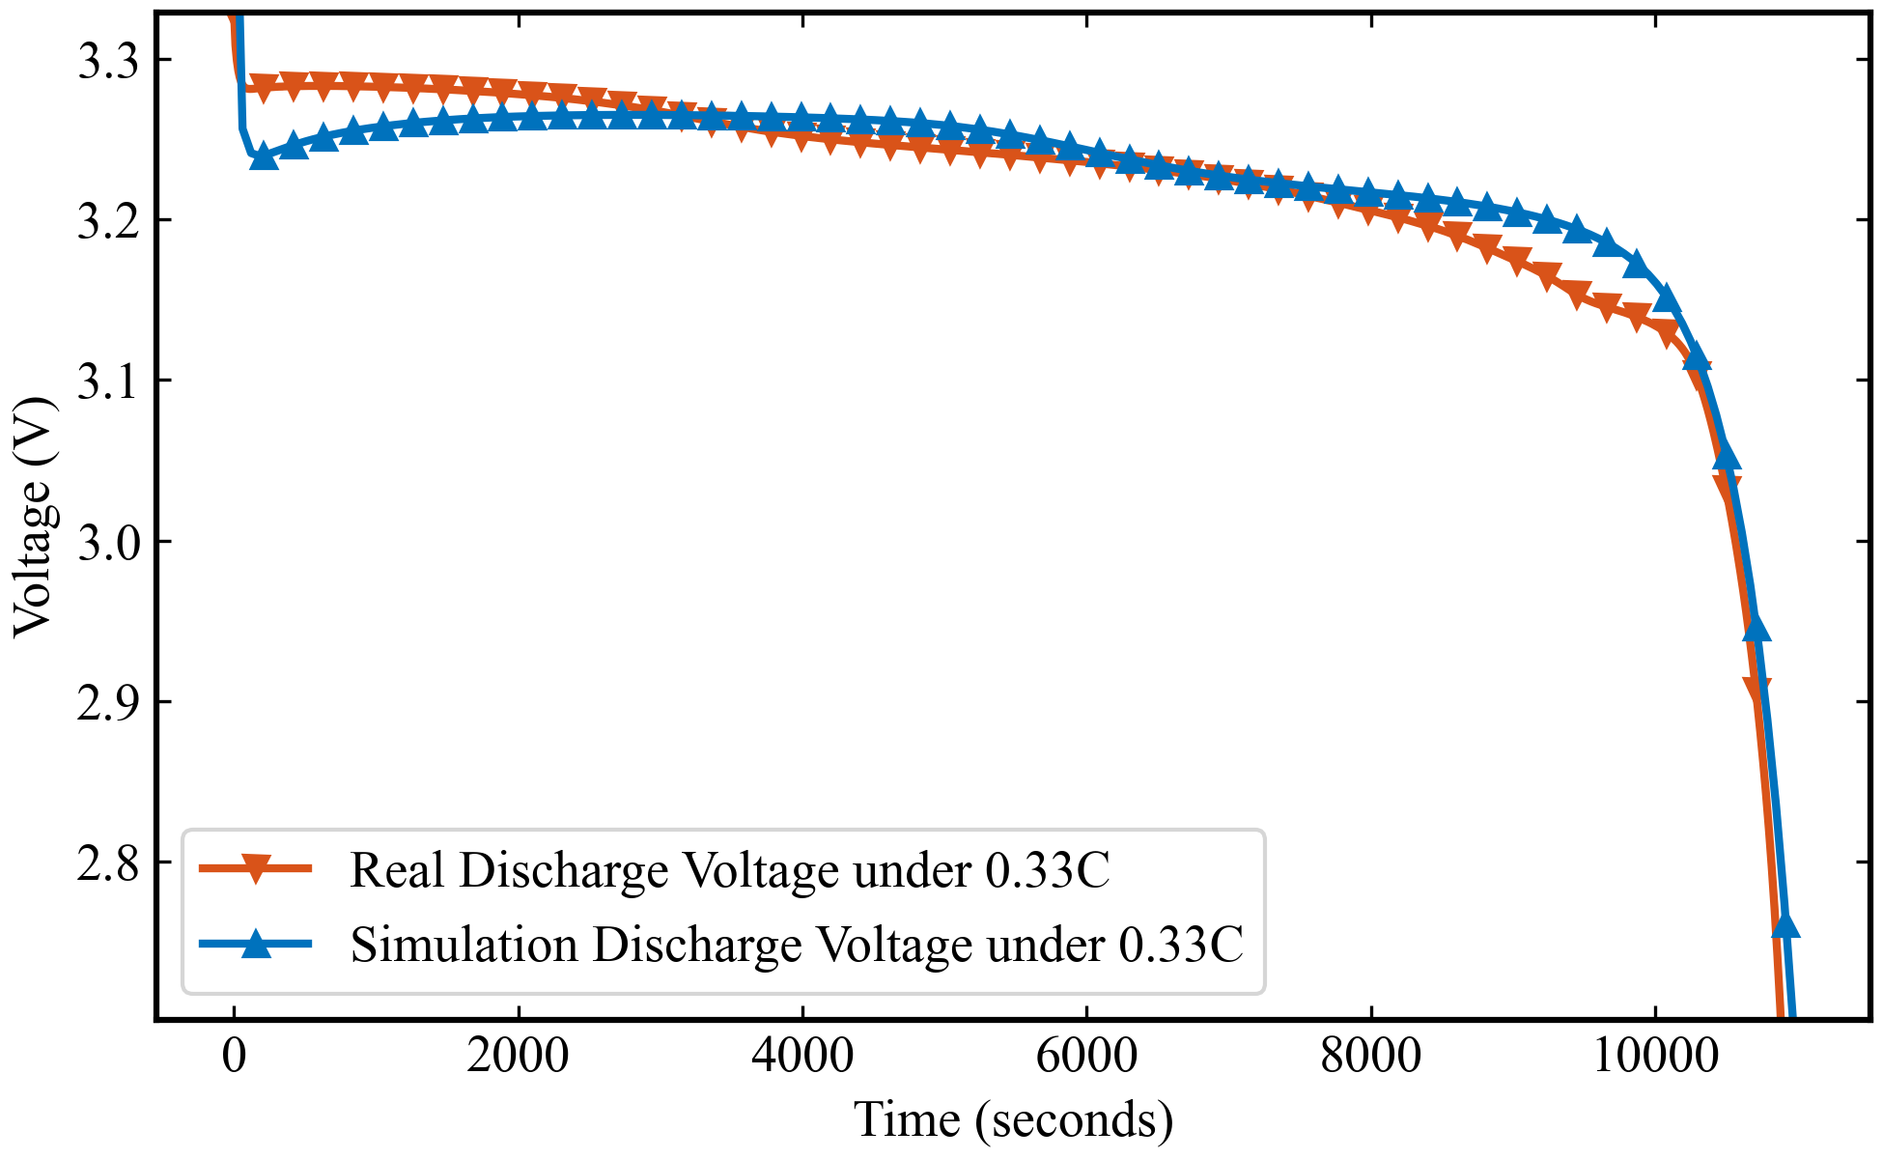
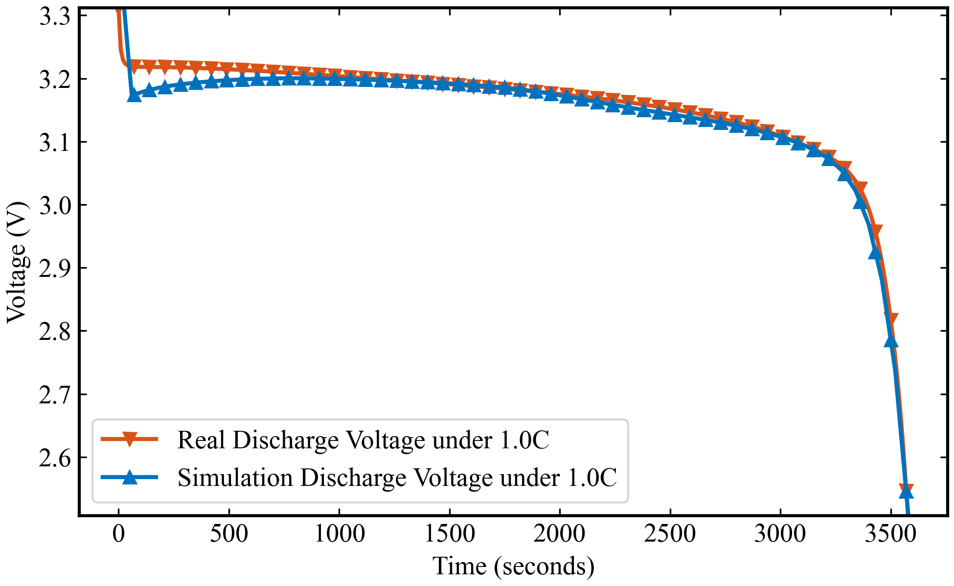
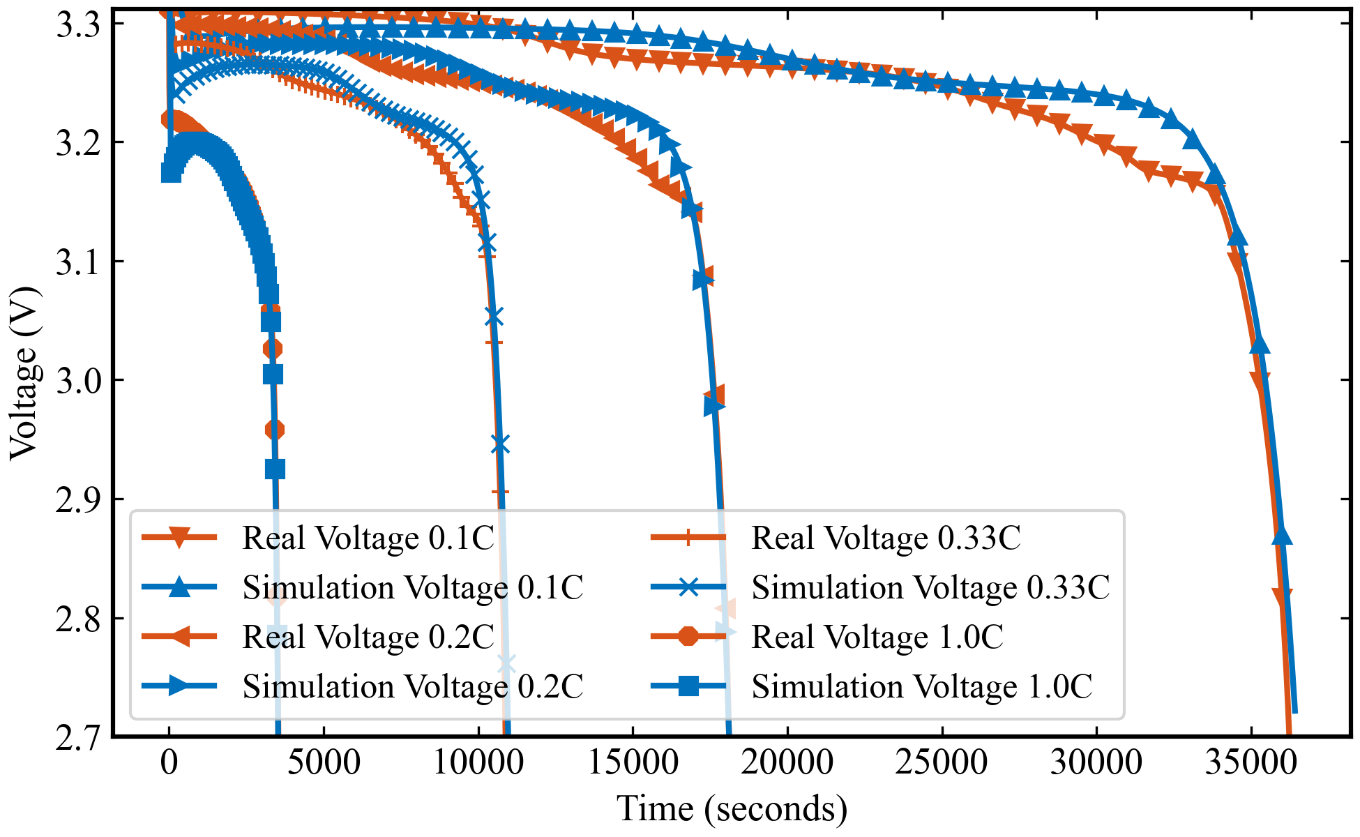
跨工况参数辨识实验结果
RMSE for 0.1C: 13.5 mV
RMSE for 0.2C: 12.2 mV
RMSE for 0.33C: 10.7 mV
RMSE for 1C: 5.3 mV
算法：NSGA 电池模型：DFN
参数量：42 跨工况联合训练，相同电化学参数，在后续的实验中，我们会加入DFN模型与SPMe模型的结果对比
DFN与SPMe模型的区别
模型维度和复杂性：DFN模型更为复杂，考虑了电极的多孔结构和详细的电化学机制，而SPMe模型则简化了这些过程，将电极视为单个球形粒子。
计算成本：DFN模型由于其复杂性，计算成本较高，而SPMe模型通过简化模型结构，显著降低了计算成本。
Notes:
Theoretical advantages:
High computational efficiency
The algorithm complexity is O (n), requiring only one traversal and simple numerical operations
No need to retrain the model, it can be directly applied to the prediction stage
Compared to sampling methods such as SMOTE, it does not increase training overhead
Good mathematical properties
Maintaining the basic constraint of probability sum of 1
Adaptive adjustment of probability distribution is achieved through threshold mechanism
The design of the amplification factor ensures the rationality of the proportion of probability redistribution

Slide 6
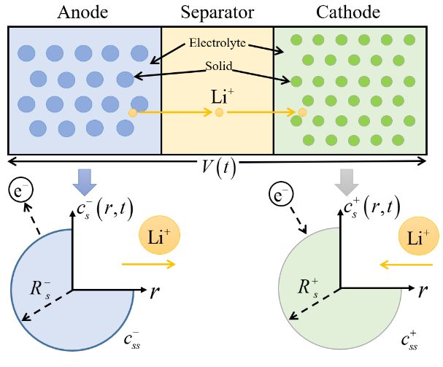
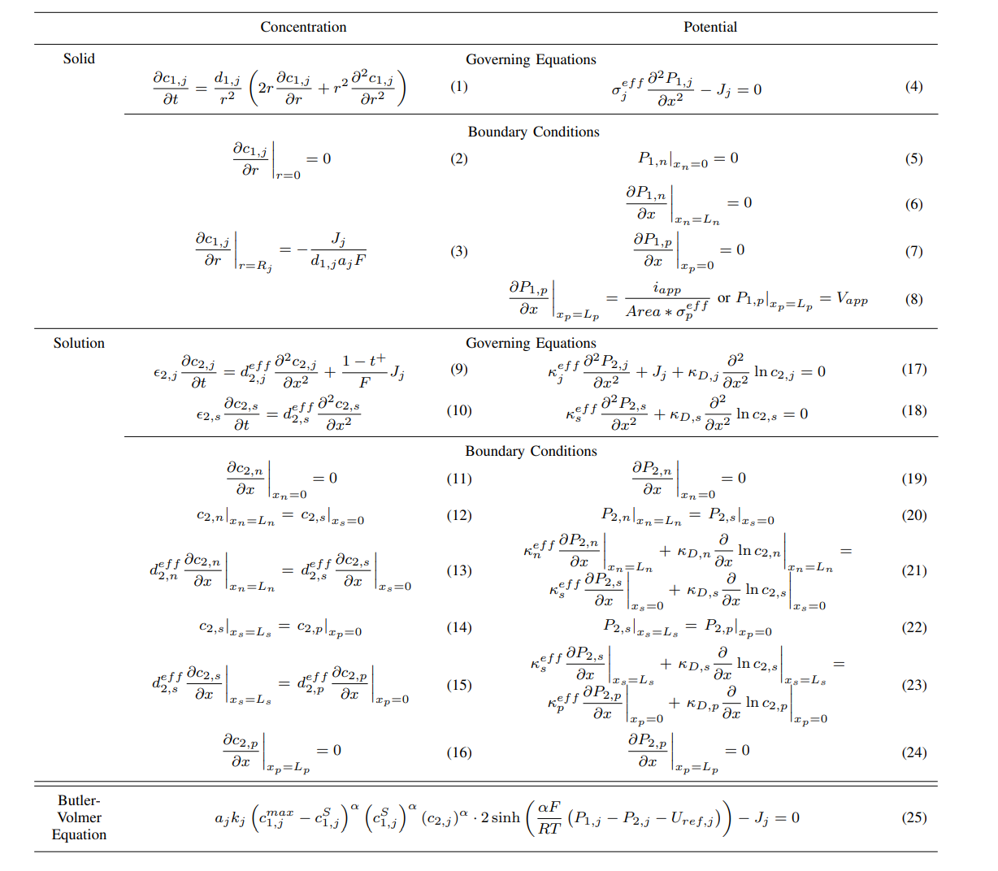
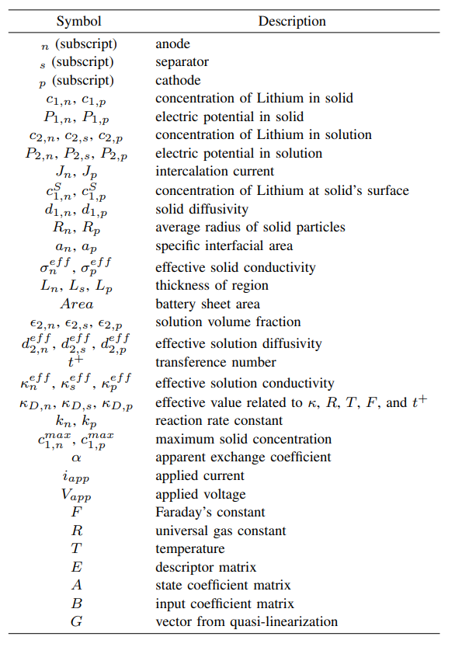
Model Description
Lithium-ion batteries are made of stacked layers of thin sheets of material: a negative current collector, an anode, a separator, a cathode, and a positive current collector.
Sketch of the DFN concept
Notes:
Theoretical advantages:
High computational efficiency
The algorithm complexity is O (n), requiring only one traversal and simple numerical operations
No need to retrain the model, it can be directly applied to the prediction stage
Compared to sampling methods such as SMOTE, it does not increase training overhead
Good mathematical properties
Maintaining the basic constraint of probability sum of 1
Adaptive adjustment of probability distribution is achieved through threshold mechanism
The design of the amplification factor ensures the rationality of the proportion of probability redistribution

Slide 7
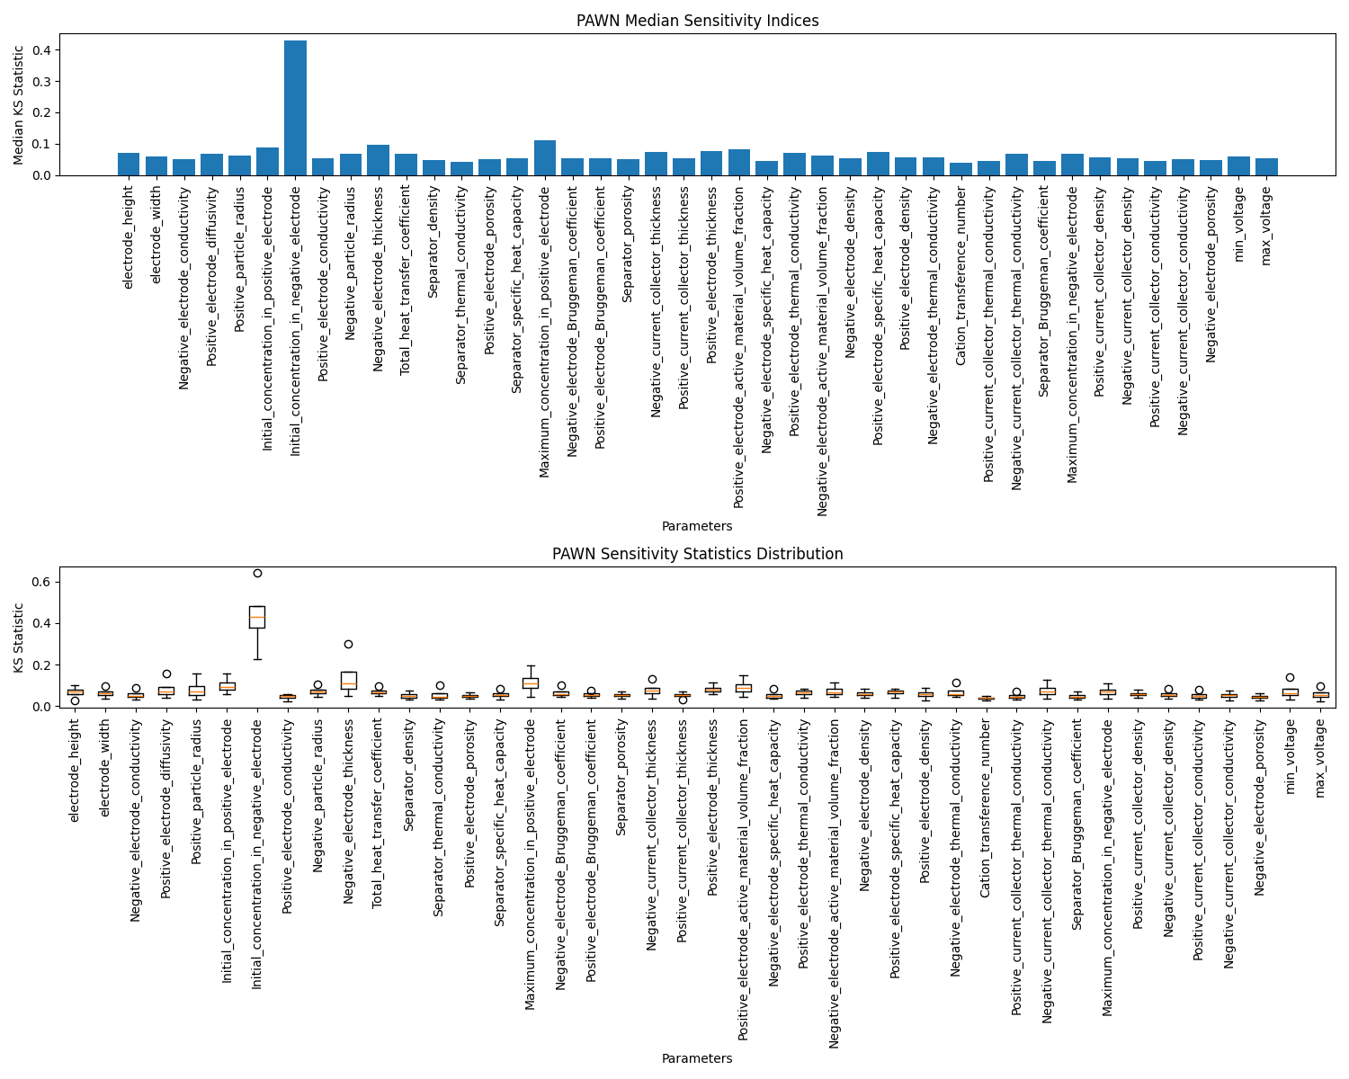
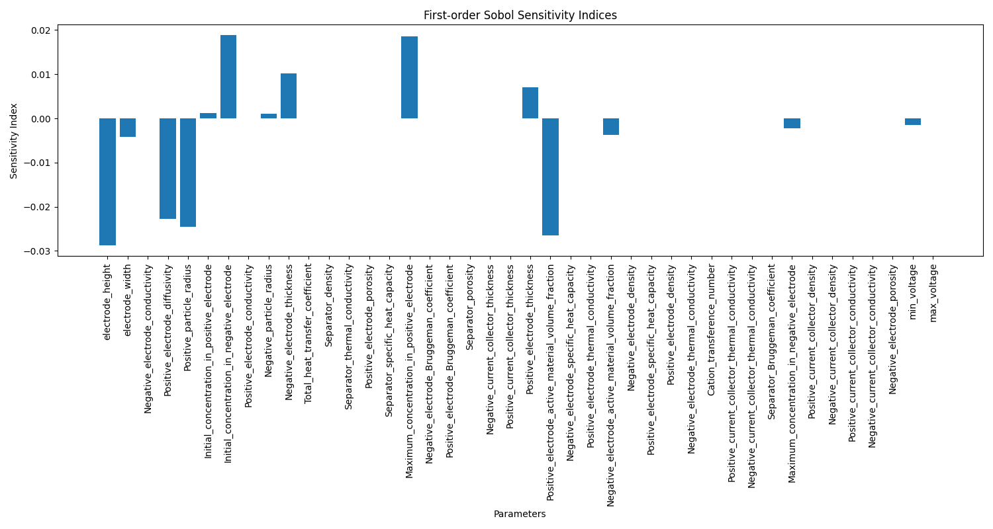
Global Sensitivity based Parameter Selection
How to design an appropriate sensitivity measure?
Voltage Mean + Voltage Stability + Voltage Flatness
Notes:
Theoretical advantages:
High computational efficiency
The algorithm complexity is O (n), requiring only one traversal and simple numerical operations
No need to retrain the model, it can be directly applied to the prediction stage
Compared to sampling methods such as SMOTE, it does not increase training overhead
Good mathematical properties
Maintaining the basic constraint of probability sum of 1
Adaptive adjustment of probability distribution is achieved through threshold mechanism
The design of the amplification factor ensures the rationality of the proportion of probability redistribution

Slide 8
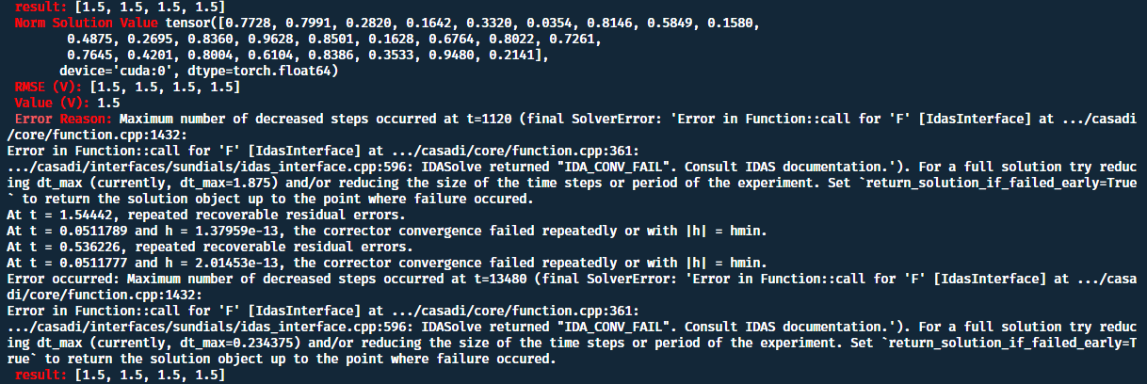
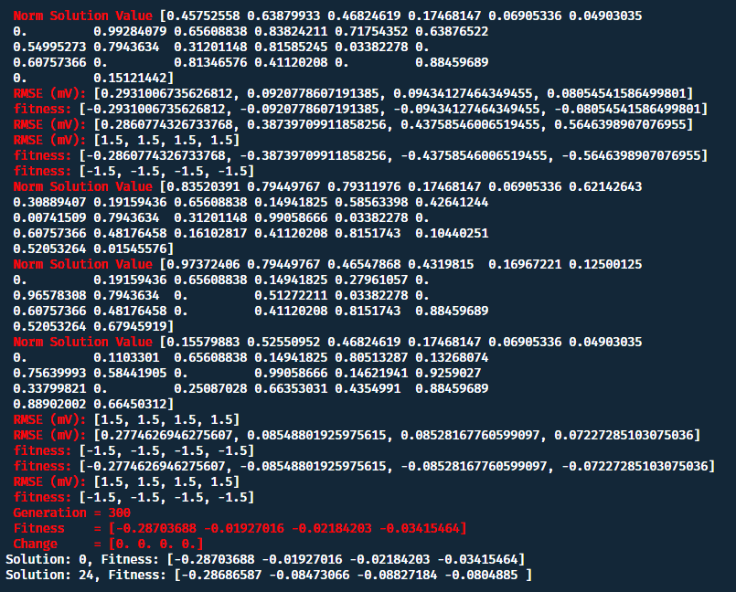
目前问题
1.贝叶斯优化采不到合适的点，不如GA
Bayes
GA
2.换了自定义电流后效果变差
Local solver
存可行点
读懂采样原理
Notes:
Theoretical advantages:
High computational efficiency
The algorithm complexity is O (n), requiring only one traversal and simple numerical operations
No need to retrain the model, it can be directly applied to the prediction stage
Compared to sampling methods such as SMOTE, it does not increase training overhead
Good mathematical properties
Maintaining the basic constraint of probability sum of 1
Adaptive adjustment of probability distribution is achieved through threshold mechanism
The design of the amplification factor ensures the rationality of the proportion of probability redistribution

